Slide 1
Mid-coast deer winter range
Work to date

Slide 2
2012 Suitability Model
Objective: “to create a simple model to guide field identification and refinement of winter range suitable for designation of UWRs for black tailed deer on the Mid Coast”
Based on information from Nyberg and Janz (1990), South Coast habitat data and input from ungulate experts.

Slide 3
Model Parameters
Attribute | Value 2012 model | Value Mid Coast Order
Aspect | 135 – 270⁰ | 135 – 270⁰ and flat ground
Slope | 40 – 100 % | < 80%
Elevation | < 900 meters (< 1000 meters in maritime)(selected 900 meters as cut off for all areas) | <= 600, <=650 maritme and sub-maritime respectively
Tree age | > =141 years (age classes 8, 9), >=100 years for high index sites (>=22) in low snowpack zones. | >=141
Crown closure | 50 – 90% | 56-85%
Tree species | Douglas fir, hemlock, or (Sitka) Spruce | Douglas fir, hemlock, or (Sitka) Spruce
Thermal/ sunshade | High | High

Slide 4
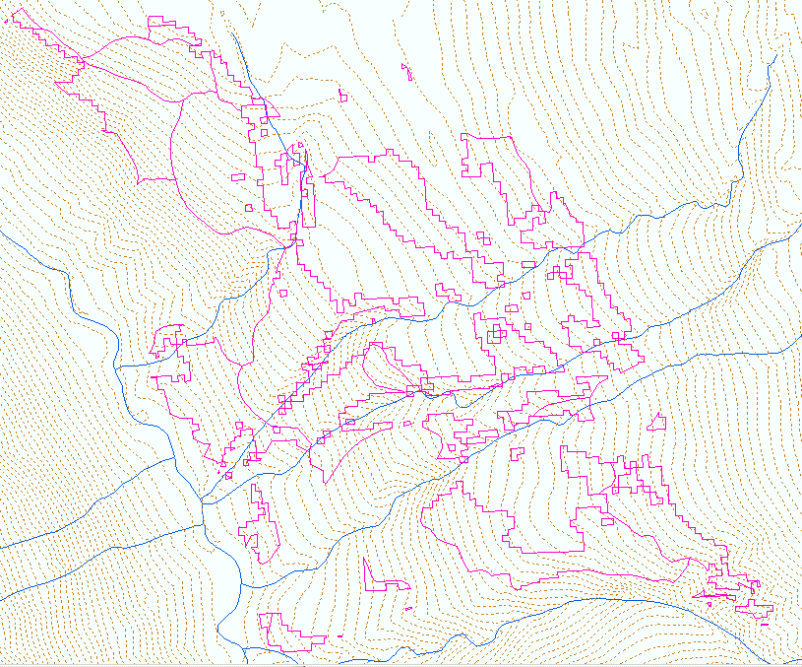
Example of 2012 output

Slide 5
Field validation of model output (2014)
Objective was to assess efficacy of the model with a focus on the maritime zone.
Measured parameters included crown closure, spp composition, elevation, aspect, and slope.
Subjective comments were included regarding forage and overall suitability (current and future).
Sample size was split to assess sites both inside (n = 28) and outside (n=27)of modelled area.

Slide 6
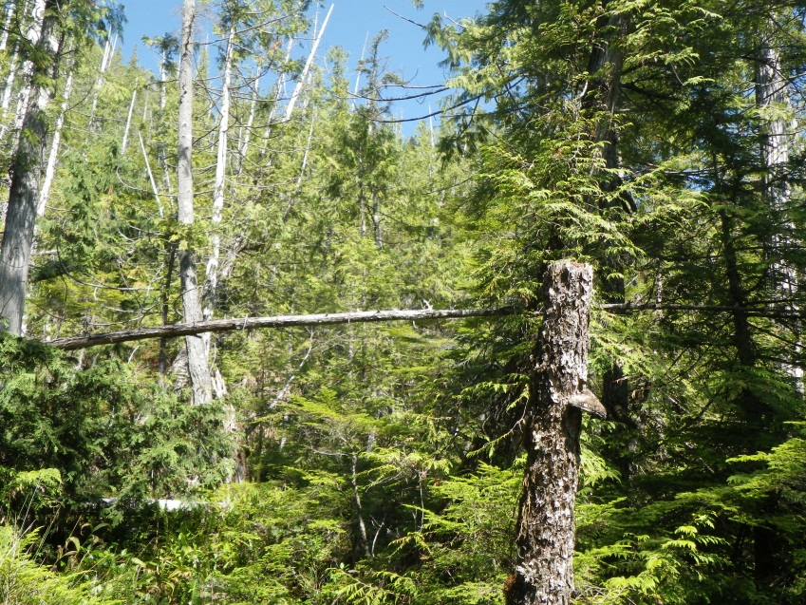
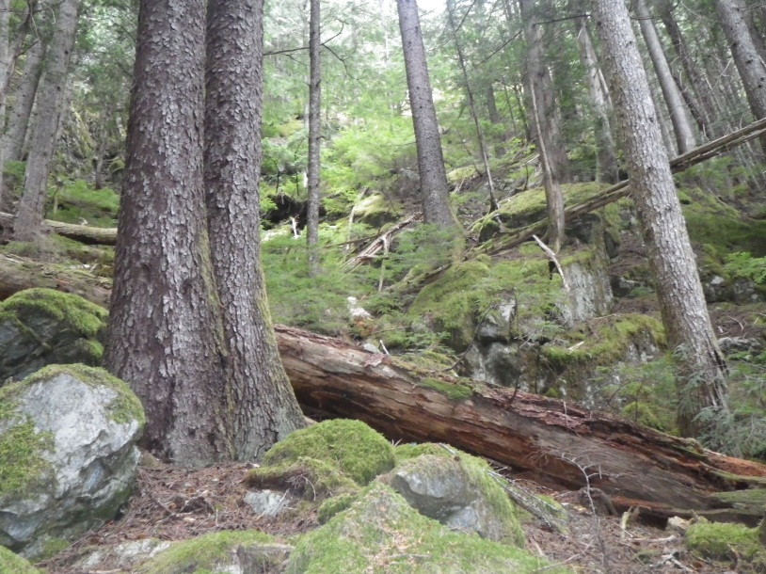
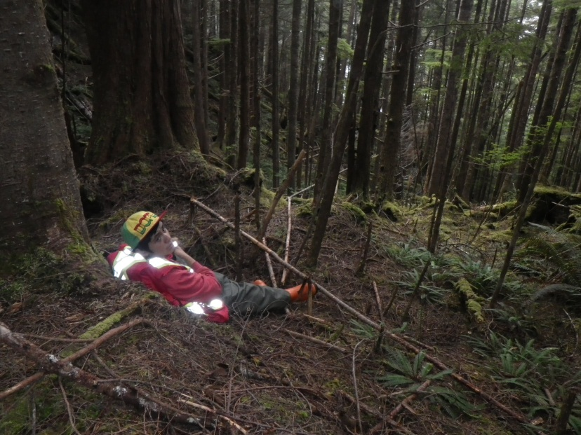
Summer 2014 Fieldwork (55 sites)

Slide 7
Summary of Results
Model was best at predicting topographic attributes.
Leading species and crown closure were often incorrect (even when newer VRI was considered).
Model was 40% accurate in identifying suitable winter range where it occurred and 60% accurate in not identifying it where it did not occur.
Limitations of verification may be associated with ground/water based surveys.
Aerial surveys were planned once all VRI data was updated.

Slide 8
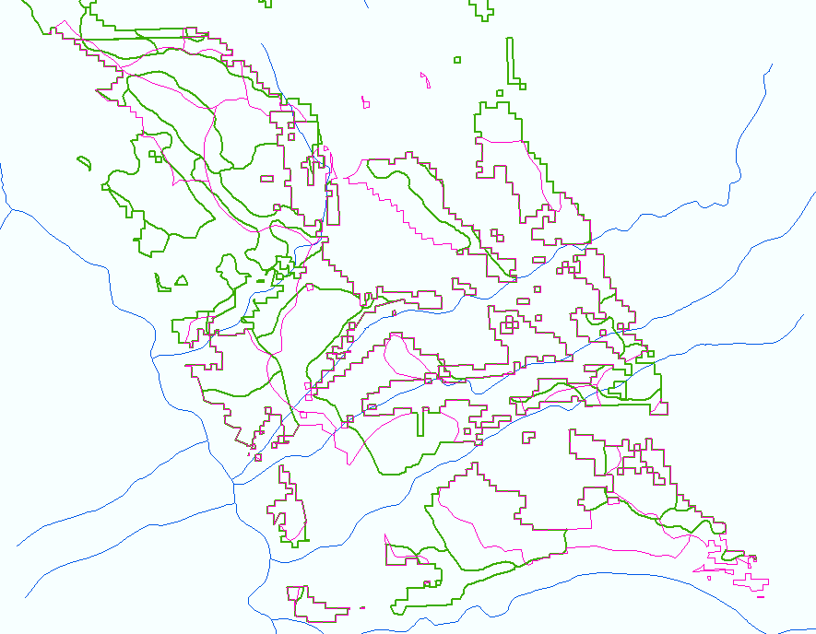
Addition of new model output based on updated forest cover (VRI) data

Slide 9
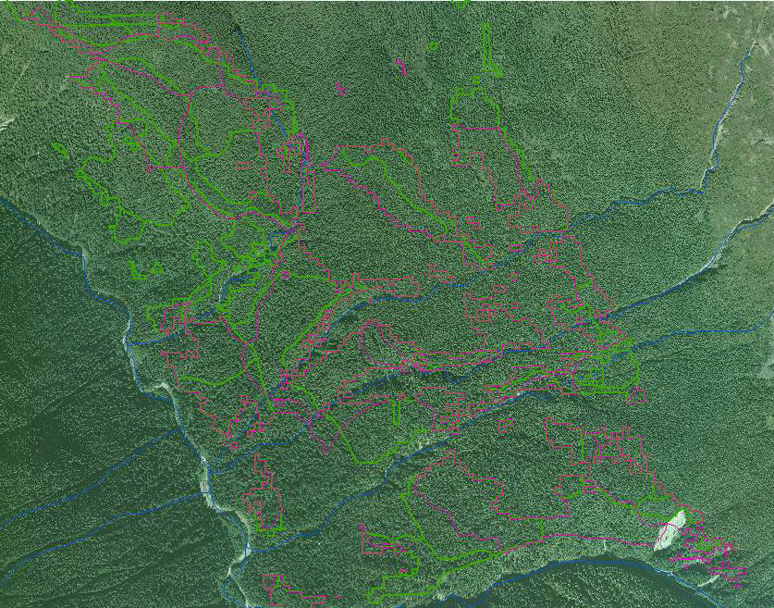
Orthophotos

Slide 10
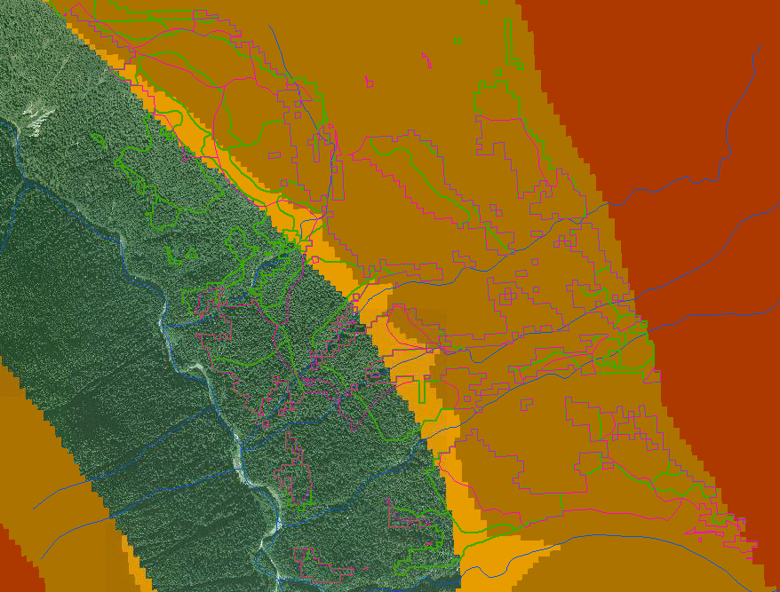
Snowpack model output (Tripp et al.)

Slide 11
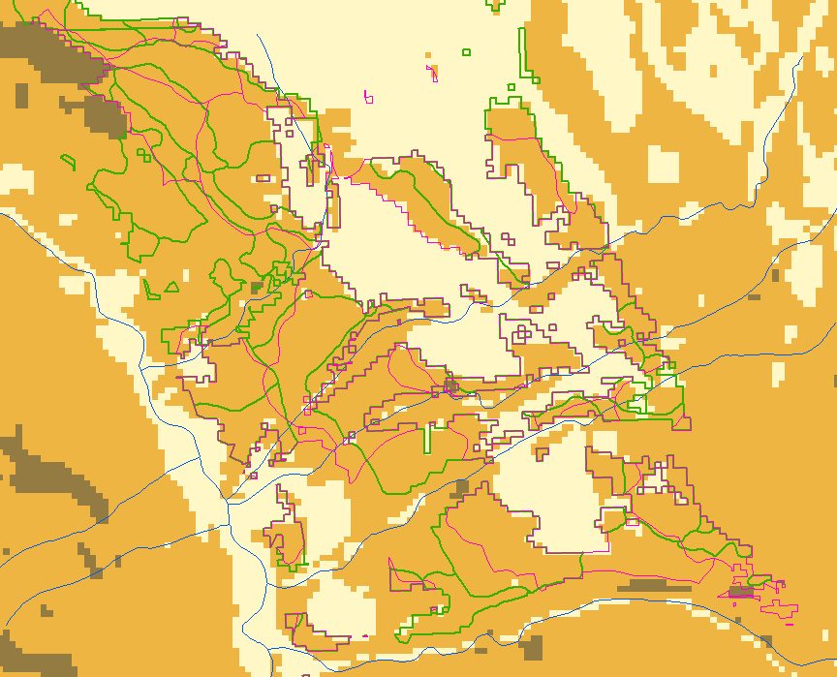
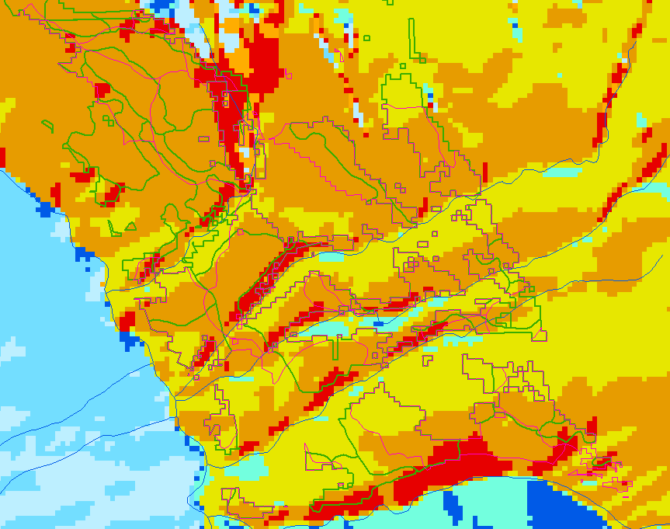
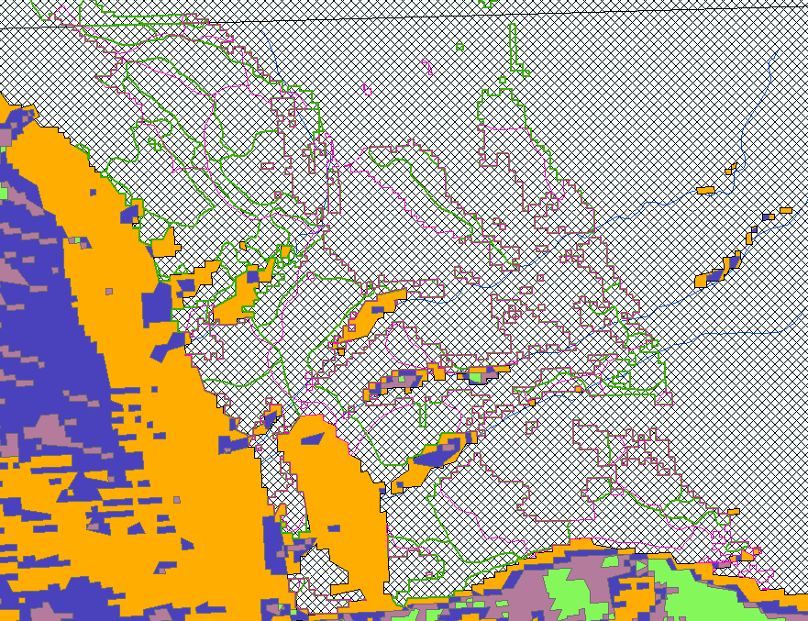
Slope, Aspect, and Sunshade rasters to confirm AOIs

Slide 12
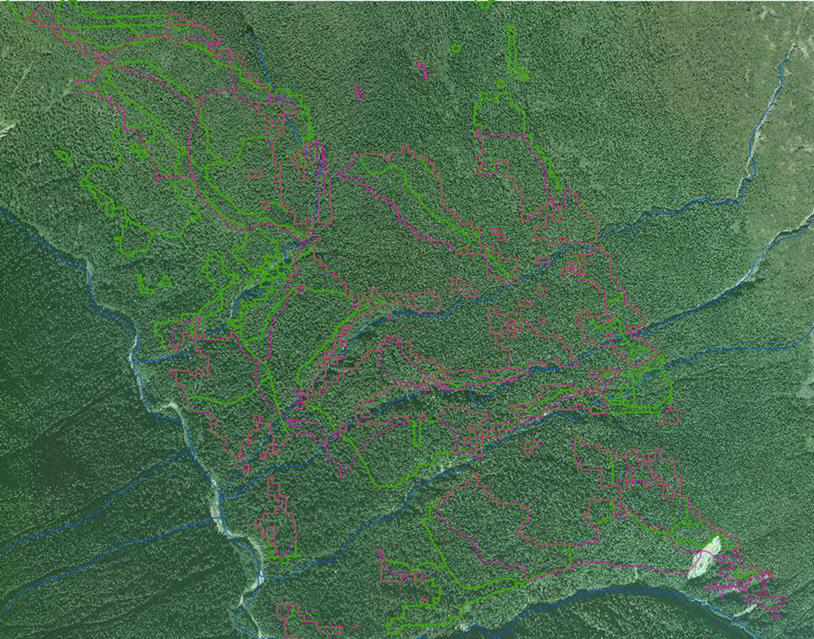
Area of Interest

Slide 13
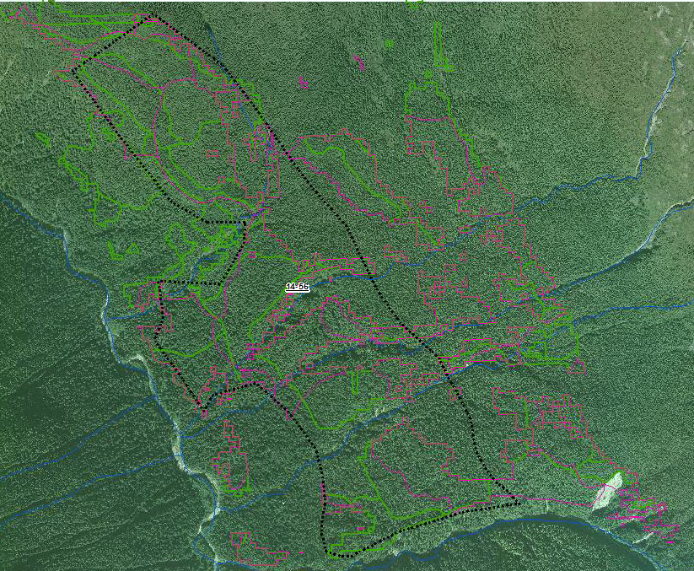
Boundary confirmation during aerial surveys

Slide 14
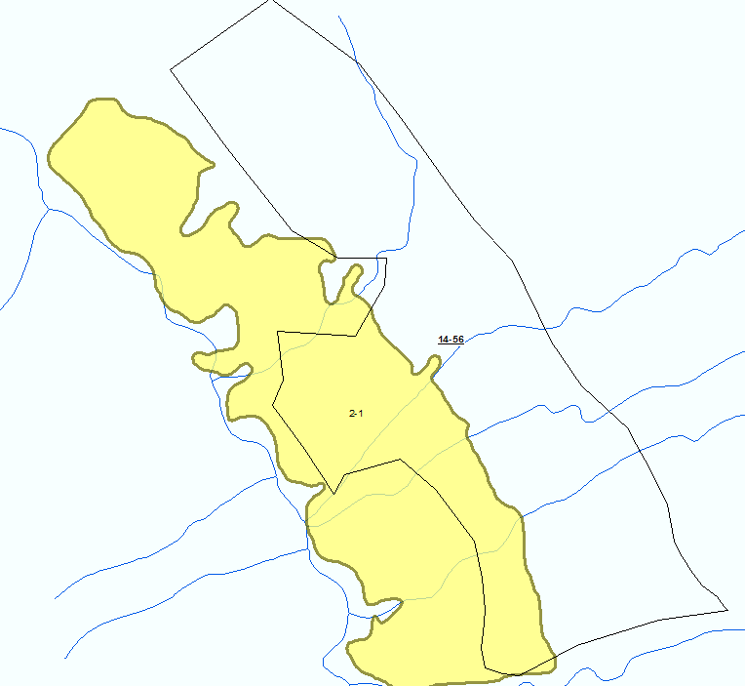
Comparison with established Specified Area

Slide 15
Limitation of the model as built
Uncertainty remains around leading species (both spatial forest cover layers).
VRI is a “strategic level” inventory.
May be too coarse in some areas to identify discrepancies at the operational level.

Slide 16
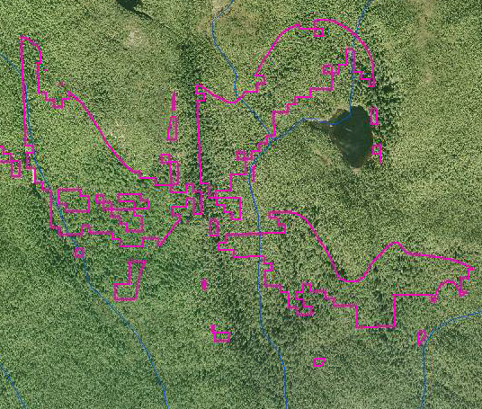
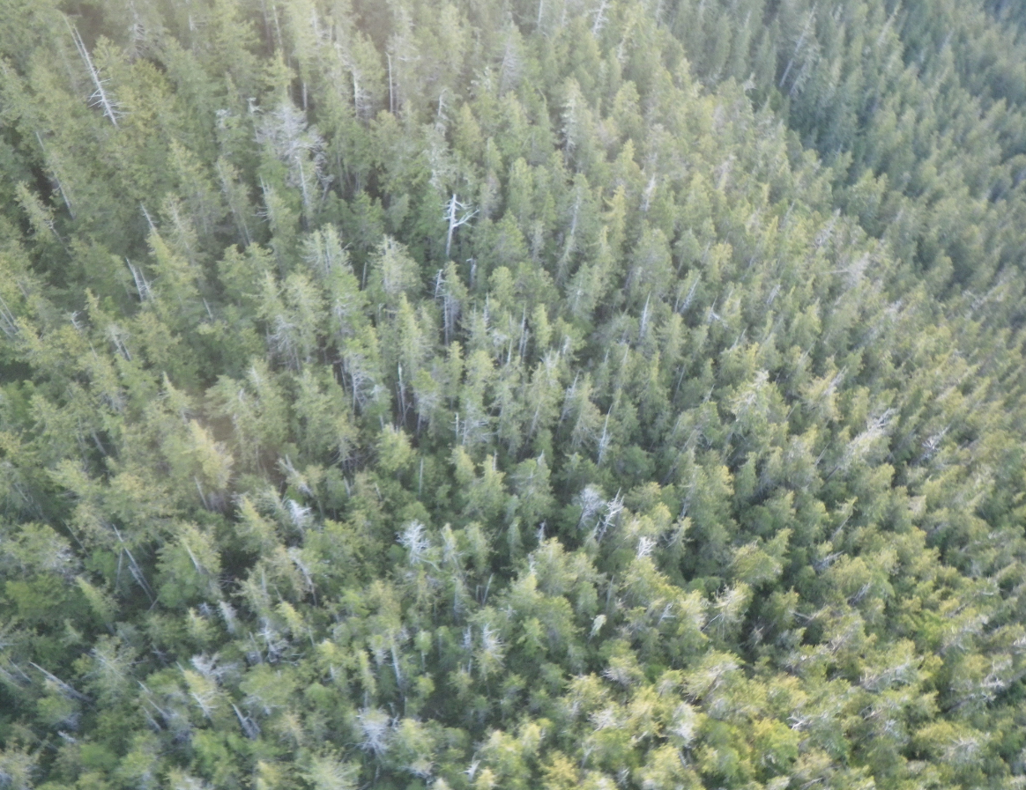
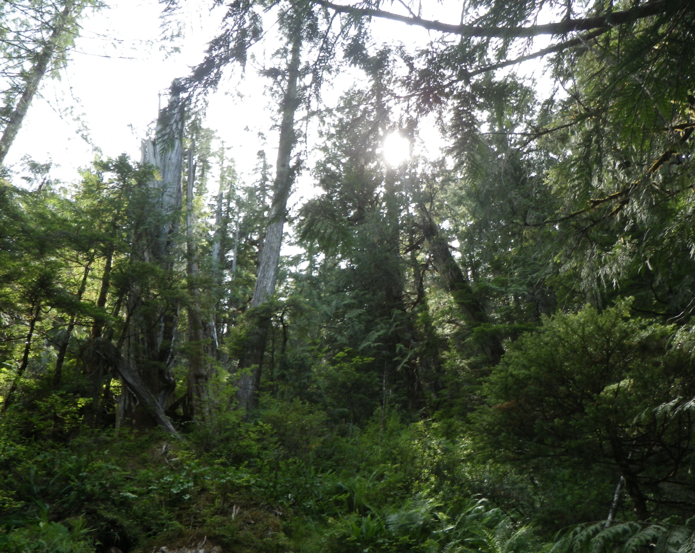
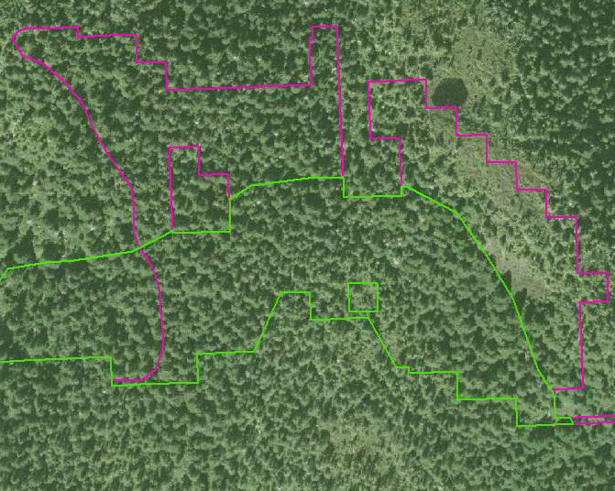
King Island
Braden River watershed

Slide 17
Model Improvement
Other VRI variables may be useful.
Field assessed AOIs were combined with VRI data and exported.
Values were grouped by whether or not the AOI was kept or removed after the aerial assessment.
Multi-collinearity among many VRI variables- linked to leading spp.
Finding significant proxy values was difficult until BEC was included as a covariate.
Further analysis by BEC for identification of significant predictor variables.
95% CI thresholds were calculated from polygons that were kept, then imported into the model in place of leading spp.
Additional AOIs are currently in progress…..

Slide 18
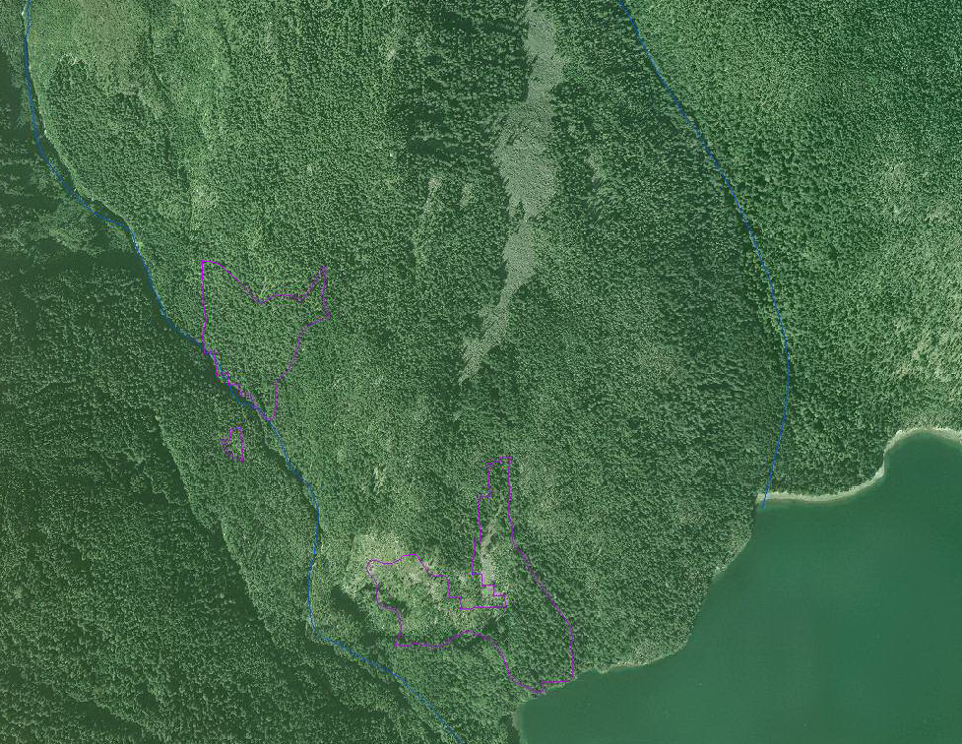

Slide 19
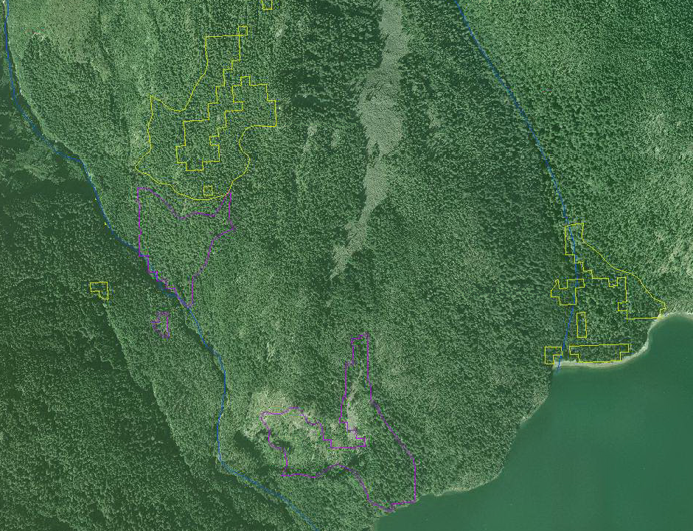

Slide 20
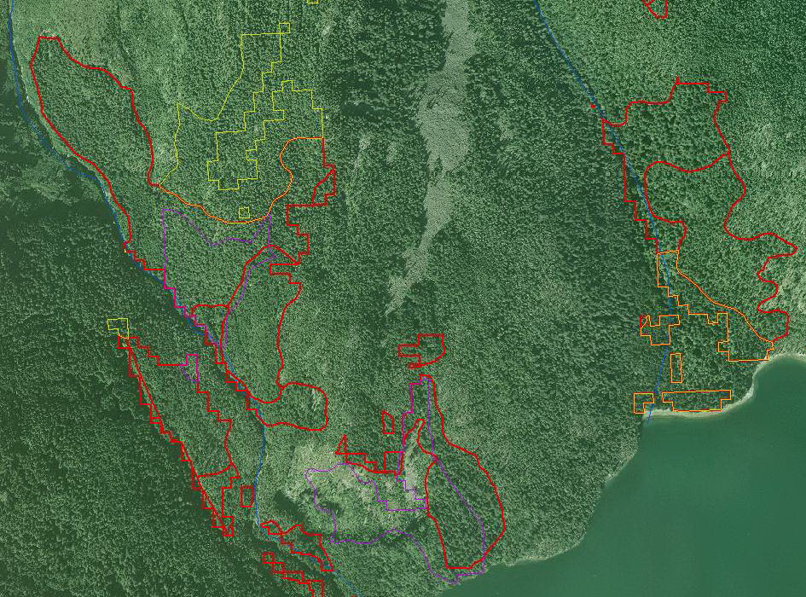

Slide 21
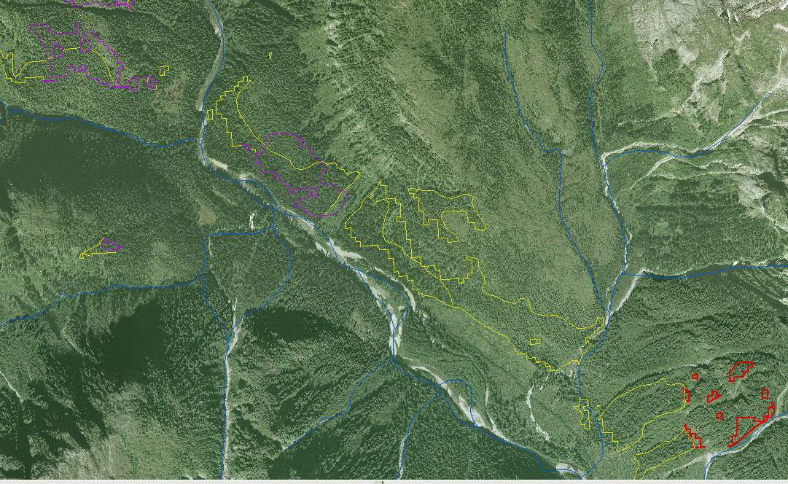
Braden River Watershed

Slide 22
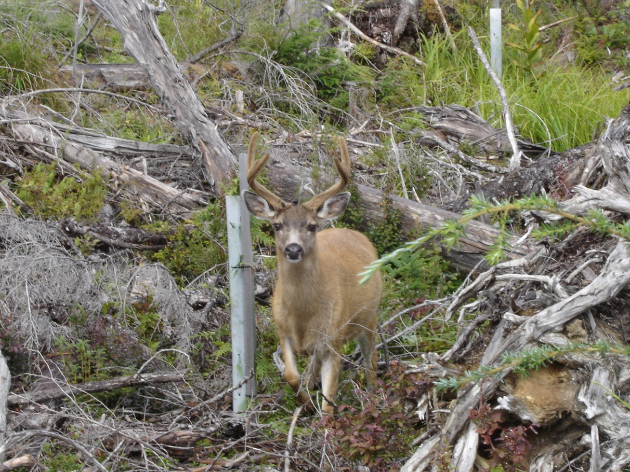
Next steps

